Slide 1
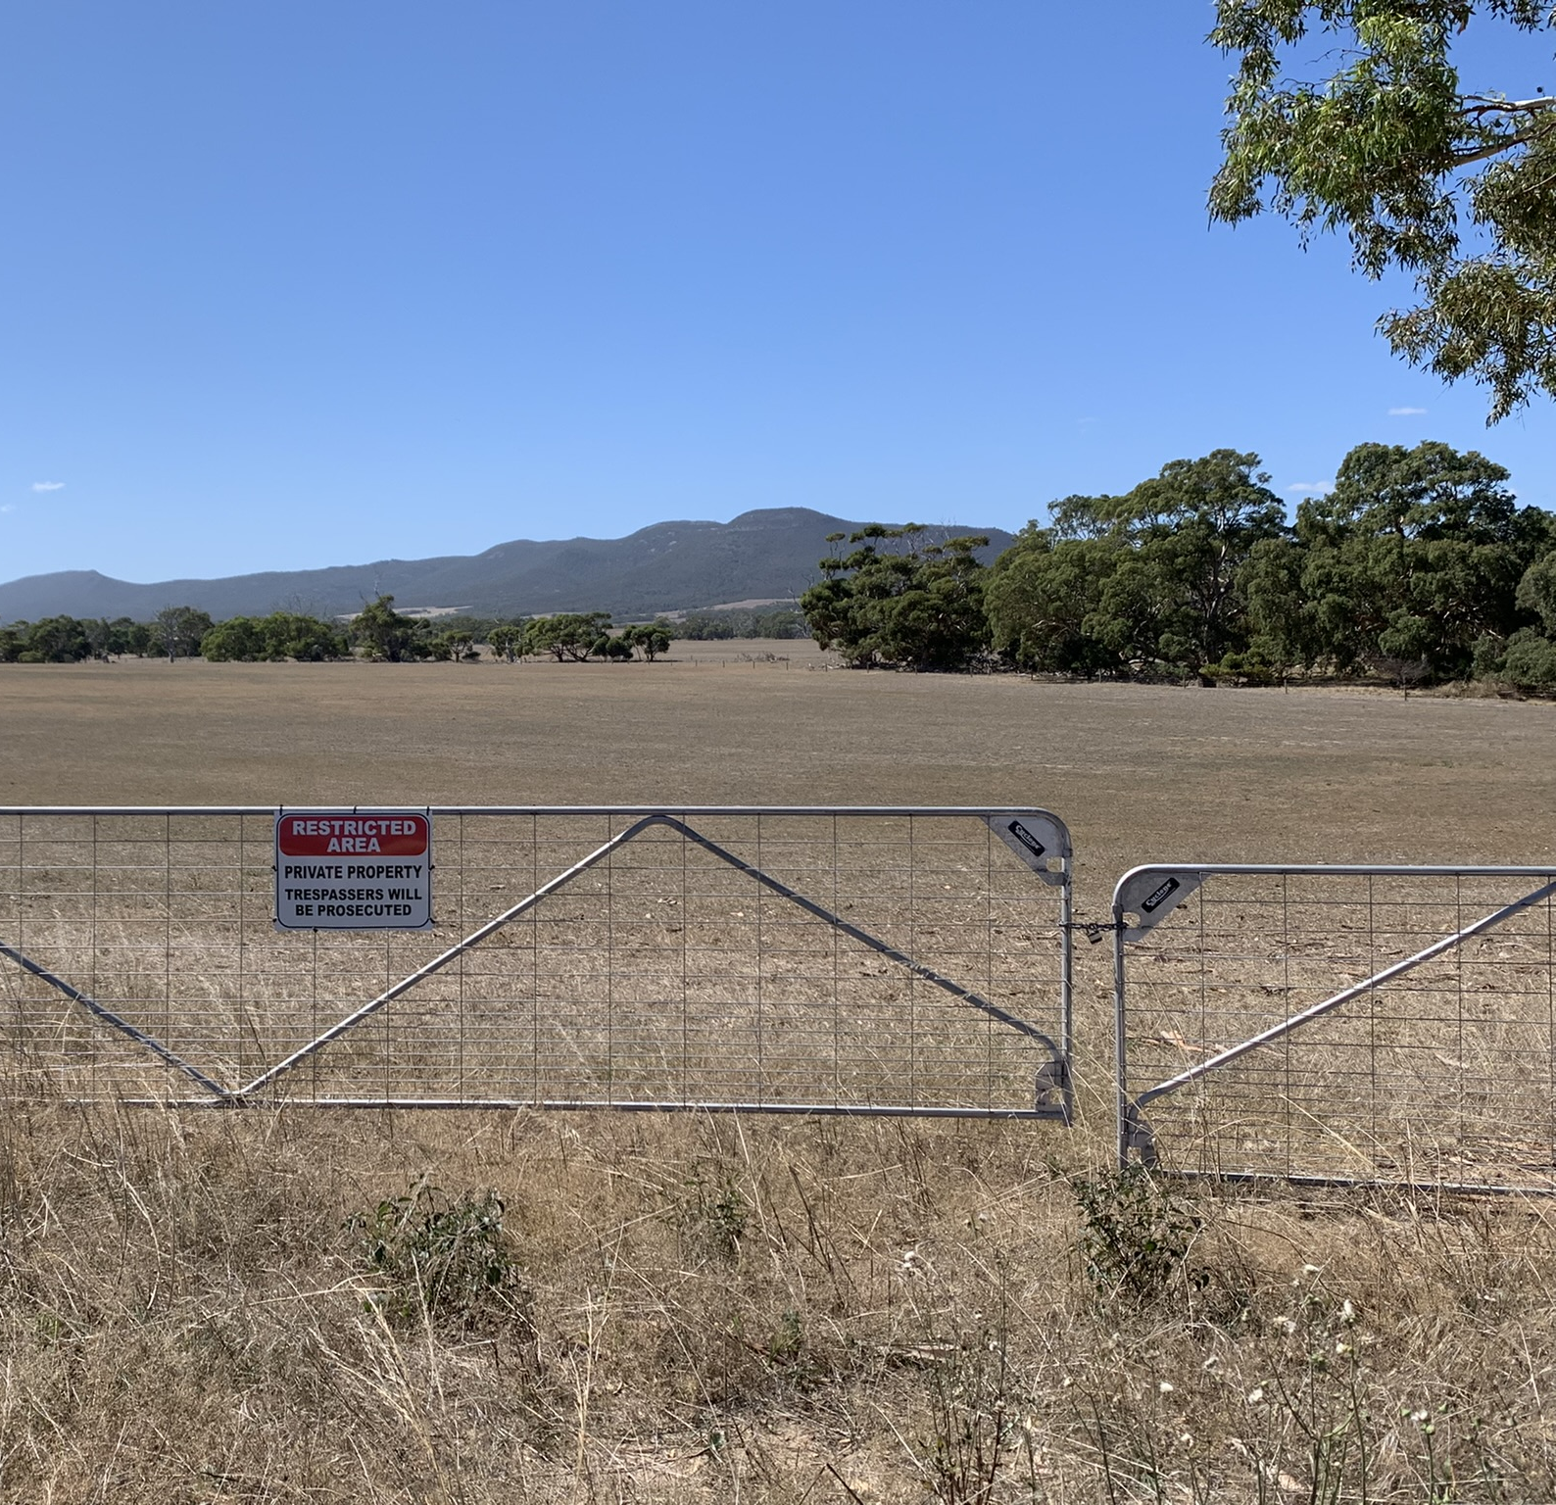
Workshop: Native title compensation research: fieldwork and reporting practicalities.
Belinda Liebelt
(SANTS Research Manager)
Craig Elliott
(Consultant Anthropologist)
Centre for Native Title Anthropology Conference, 8-9 Feb 2024, 1.30 - 3.00 pm, Lincoln College, North Adelaide.
Notes:
Title Slide
Welcome everybody, thank you for attending. If you’ve somehow joined this workshop without reading through what it is about, today we will be working through some of the complexities of the applied native title compensation work that Craig and myself have experienced in South Australia. That said, I recognise there are several very experienced compensation practitioners in the room, and we also hope to draw on that experience and knowledge today by working collaboratively through the afternoon.

Slide 2
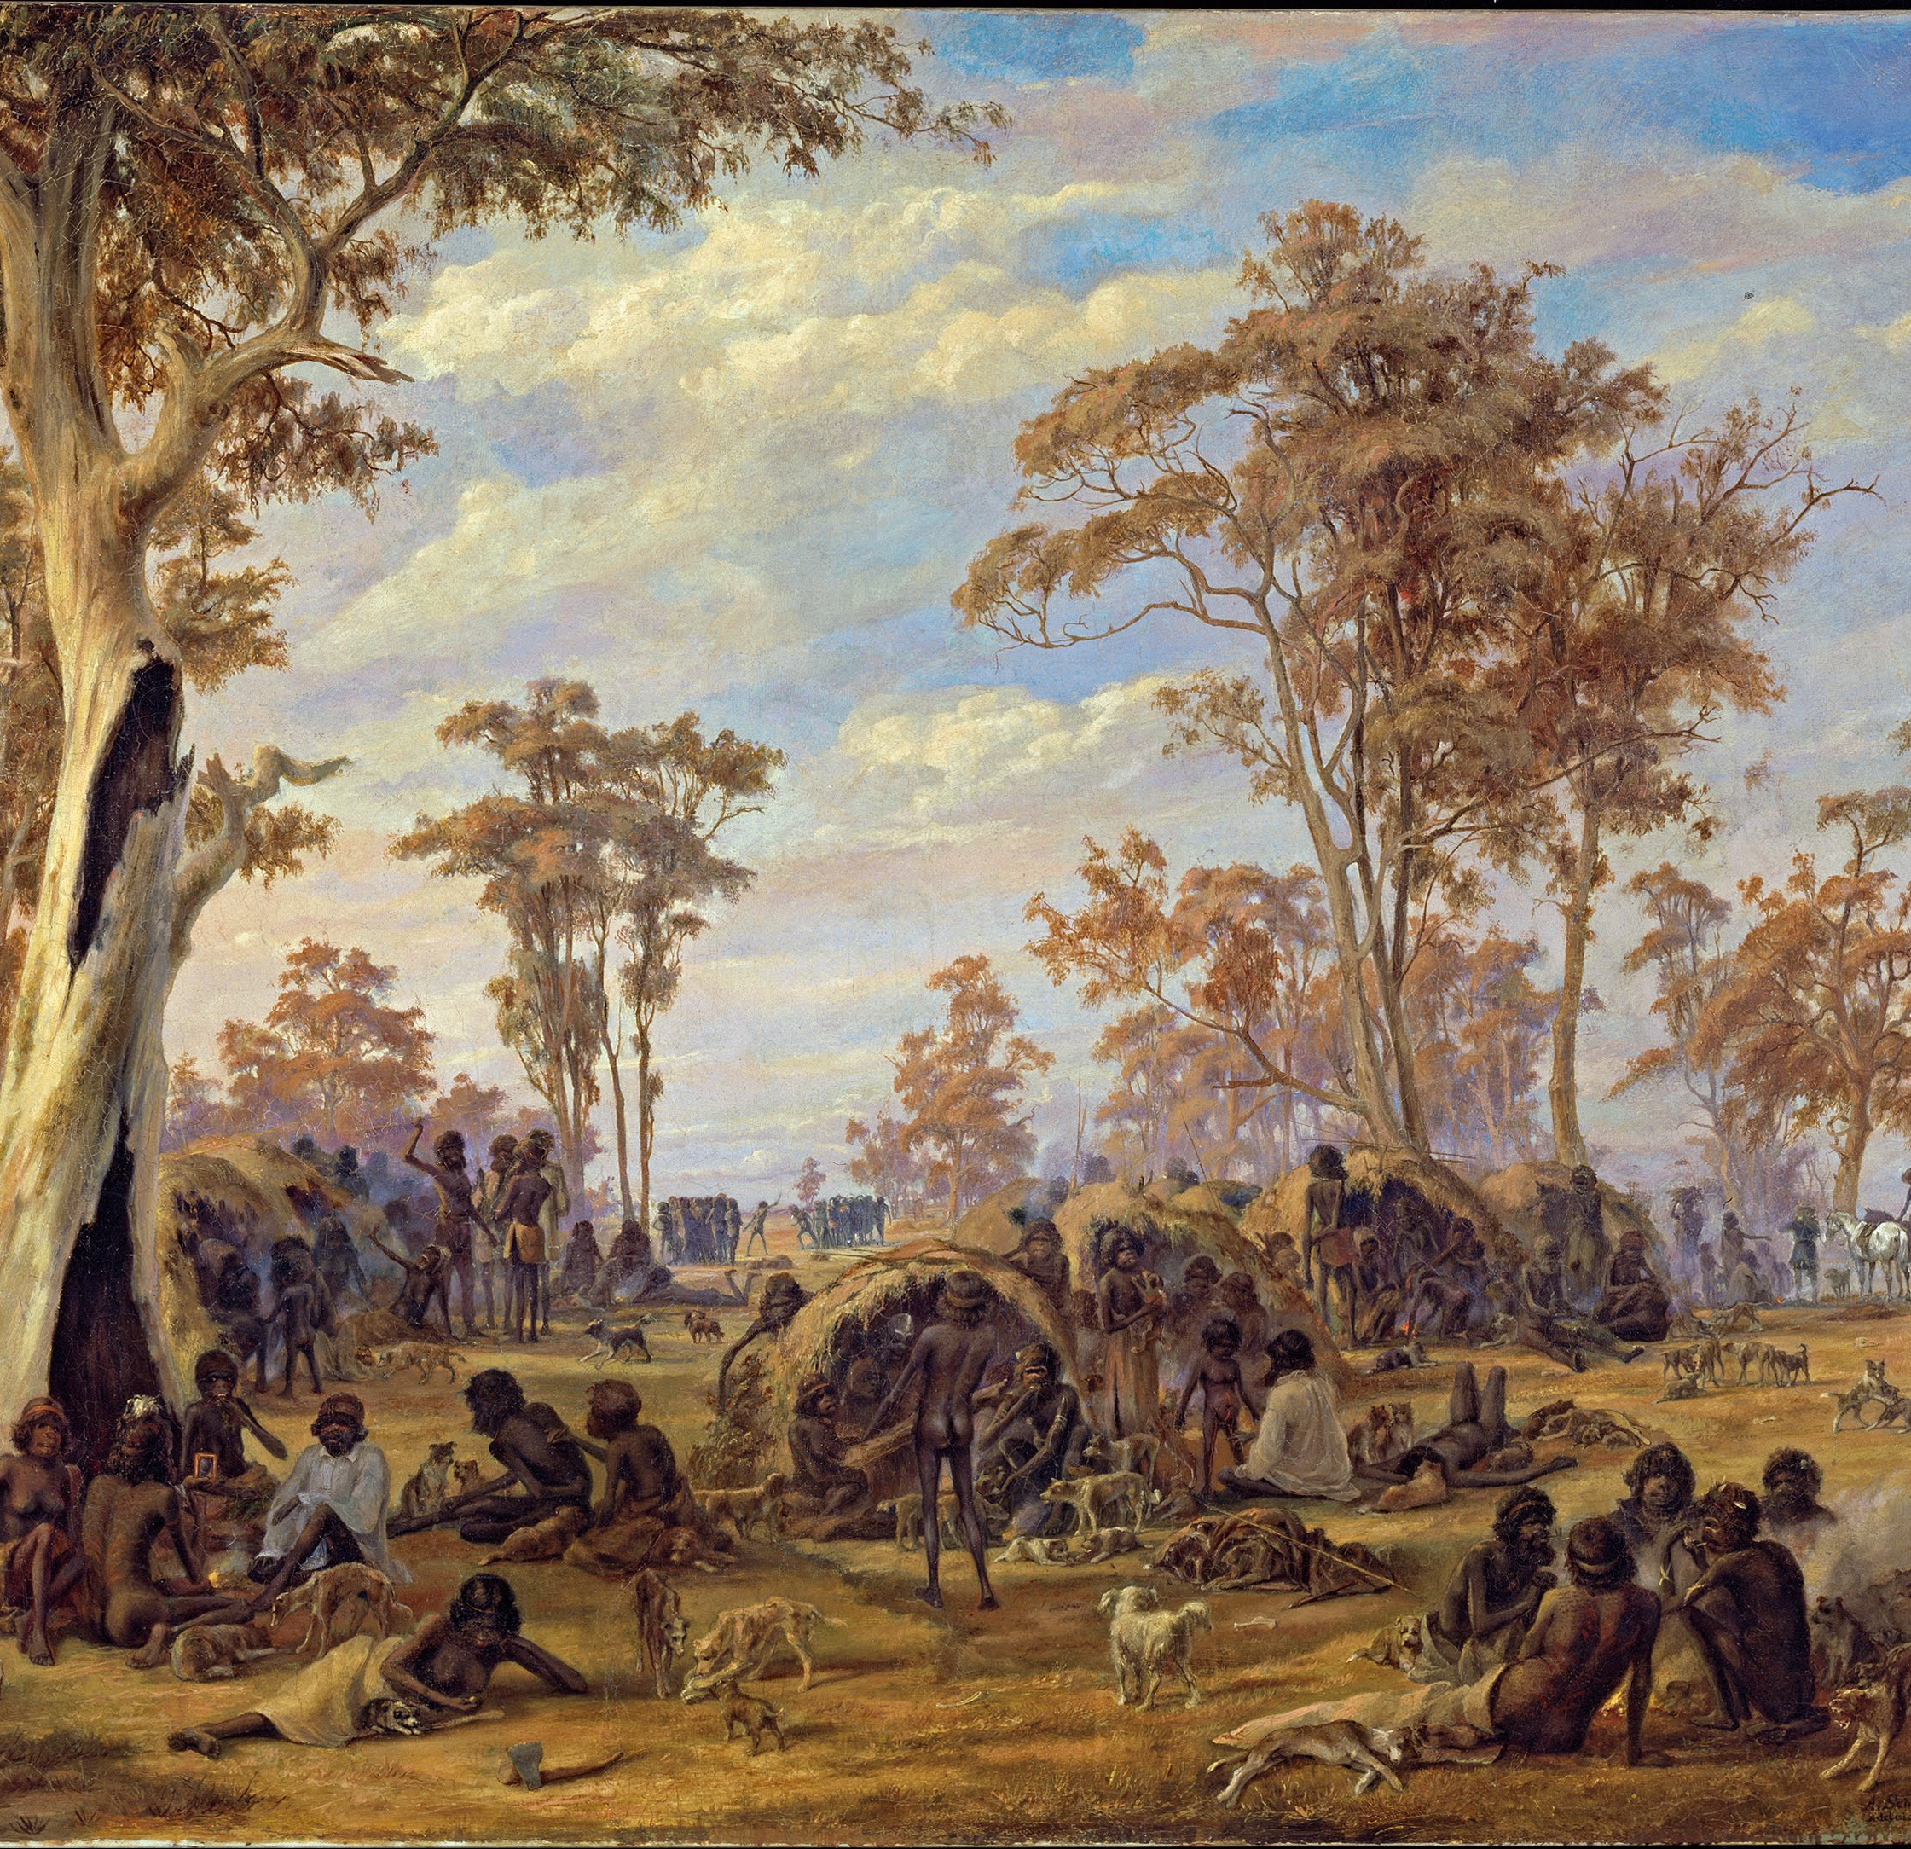
Acknowledgements
We meet today on the customary lands of Kaurna Aboriginal people, whose descendants are today represented by the Kaurna Yerta Aboriginal Corporation.
(Image: Alexander Schramm 'Adelaide, a tribe of natives on the banks of the river Torrens' 1850)
Notes:
Acknowledgements
Before we begin, I would like to acknowledge the Kaurna people as the customary landholders of the country we gather on today. Here in North Adelaide we are just north of the Torrens River, a place which has long been recognised as a Kaurna meeting place of high cultural and spiritual significance, something I think is captured beautifully in this painting by Schramm in 1850. Kaurna people received their native title determination over portions of their land in 2018. I’d like to extend my respects to Kaurna Elders, past and present, and recognize their continuing connection to their land.

Slide 3
Workshop Outline
Introductions
Definitional
Small Group Exercise
Small Group Reflections & Discussion
Notes:
Workshop Outline – Craig

Slide 4
Introductions
Belinda Liebelt (SANTS Research Manager)
Craig Elliott (Consultant Anthropologist)
Notes:
Introduction
I have been working in native title for approximately 7 years, prior to this I was undertaking my PhD and before that I was working as a heritage consultant. Compared with many people in this room, I would say my native title experience is comparatively short, although I have acted as an expert witness in two trial proceedings in that time, which have been in many ways a ‘trial by fire’ in terms of understanding native title anthropology practice. I am increasingly asked to undertake compensation research in my role at SANTS. Throughout 2022 and part of 2023 I researched and supplied advice relating to cultural loss for the Nauo and Nauo 2 native title claims, the first of those was jointly written with Scott Cane. In the last two weeks I have been briefed to provide two further assessments for other claim groups this year, so this workshop is timely in terms of picking all your brains and soaking up the wealth of experience in the room.

Slide 5
Definitional: cultural loss
Richard Martin (2023, p. 633) notes that in 2019 the High Court amended the decision to replace payment in solatium with money for “cultural loss,” which was construed by the court as compensable damage inflicted by another on the cultural value of native title. Martin notes that, in this legal usage, “compensation” is not an award to cover distress caused by extinguishment but is rather a valuation of the damage to “culture.”
In other words, in a native title compensation framework, “cultural loss” refers to the potential loss or damage to elements of traditional law and custom held by a group brought about via a specific act or series of events (which have been deemed to be compensable). As Martin explores (and will discuss further tomorrow), this legal interpretation is somewhat different to existing anthropological understandings relating to cultural loss and culture change through time.
Martin, Richard (2023). Cultural loss and compensation in the anthropology of Aboriginal Australia. American Ethnologist 50 (4) 632-644.
Notes:
Definitional – cultural loss
While we don’t intend on spending much time talking at you today, we do think it is important to briefly touch on a few definitions regarding the developing jurisprudence around cultural loss, and what this might mean for native title practitioners, particularly anthropologists.
In terms of understanding cultural loss, Richard Martin’s most recent article provides a useful explanation.
Richard Martin (2023, p. 633) notes that in 2019 the High Court amended the decision to replace payment in solatium with money for “cultural loss,” which was construed by the court as compensable damage inflicted by another on the cultural value of native title. Martin notes that, in this legal usage, “compensation” is not an award to cover distress caused by extinguishment but is rather a valuation of the damage to “culture.”
In other words, in a native title compensation framework, “cultural loss” refers to the potential loss or damage to elements of traditional law and custom held by a group brought about via a specific act or series of events (which have been deemed to be compensable). As Martin explores (and I note that he will discuss further tomorrow), this legal interpretation is somewhat different to existing anthropological understandings relating to cultural loss and culture change through time.
Working with Martin’s definition, I wonder about whether we should be now working backwards in native title? While connection research asks us to identify a group’s shared laws and customs that give rise to their rights and interests in country, does compensation work now mean we are asked to consider how impacts to those same rights and interests in country might irreversibly cause injury to elements of Aboriginal law and customary practice? Or perhaps it is not that simple?

Slide 6
Definitional: cultural loss
Comparatively, Sandra Pannell (2019, p. 4) says that:
“In my view, in focusing upon ‘cultural loss’, the High Court has made it quite clear that they are not speaking about the loss of culture … but of loss, or ‘a sense of loss’, because of culture. In other words, while the idea of ‘hurt feelings’ suggests an individual psychobiological feeling state, independent of culture, ‘cultural loss’, on the other hand, conveys a ‘sense of loss’ based on cultural concepts and beliefs, being those acknowledged and observed by all of the members of the claim group”.
“…the 2019 High Court judgment has sent a very clear message to practitioners that, in future compensation claims, the focus of our investigations should be upon the cultural value accorded rights and the cultural significance ascribed to land, by Indigenous people. The High Court has provided us with some idea as to what cultural value and its loss means for anthropologists researching compensation claims.”
Pannell, Sandra (2019) What Do William James and Franz Boas Have to do with Compensation Claims?: An Exploration of Emotion and Culture in Indigenous Compensation Claim Research. National Native Title Council Conference Paper, Melbourne 3-4 June, 2019.
Notes:
Definitional – cultural loss
We can compare Richard Martin’s explanation with Sandra Pannell’s, who I think has provided a slightly different interpretation on the Timber Creek decision.
“In my view, in focusing upon ‘cultural loss’, the High Court has made it quite clear that they are not speaking about the loss of culture … but of loss, or ‘a sense of loss’, because of culture. In other words, while the idea of ‘hurt feelings’ suggests an individual psychobiological feeling state, independent of culture, ‘cultural loss’, on the other hand, conveys a ‘sense of loss’ based on cultural concepts and beliefs, being those acknowledged and observed by all of the members of the claim group”.
“…the 2019 High Court judgment has sent a very clear message to practitioners that, in future compensation claims, the focus of our investigations should be upon the cultural value accorded [to] rights and the cultural significance ascribed to land, by Indigenous people. The High Court has provided us with some idea as to what cultural value and its loss means for anthropologists researching compensation claims.”
So, while I’m not certain that Sandra is right when she says the High Court has sent us a “clear message”, I am intrigued by both Martin’s and Panell’s descriptions of how anthropologists might come to understand the concept of cultural loss within a native title framework. In particular, Sandra’s note on cultural loss as a shared “sense of loss”, informed by the cultural values, concepts, emotions, and beliefs that unite Aboriginal groups and connect them to their country, is a valuable observation. I would be interested in hearing colleagues’ views on these descriptions during this workshop.

Slide 7
Definitional: compensable acts and effects
Northern Territory vs Griffiths [2019] describes 53 compensable acts in relation to various grants of tenure over land parcels within the town of Timber Creek, which were later held to have impaired or extinguished the Ngaliwurru and Nungali Peoples native title rights in those areas. The compensable acts were listed as occurring at the date of the granting of the tenure for each parcel (variously between 1980-1996).
Of note however, the High Court noted that there were “four events … which were not the direct result of compensable acts” but which were effects of those acts after the granting of the tenure. The Judge said that these events helped to explain why the “compensable act itself has a compensable effect which is not one dimensional”, leading the Judge to conclude that “the consequences of [compensable] acts can be incremental and cumulative”.
Notes:
Definitional – compensable acts and compensable effects.
Moving on now to a second concept integral to understanding compensation, compensable acts. Compensable acts are grants over land that impair or extinguish native title.
(Craig – notes from P. Burke).
The Timber Creek judgements identified two compensable components to compensable acts - the economic value (which the High Court found at 50% of the freehold value of the land at the time of extinguishment) and the noneconomic value of the rights and interests affected (deemed to be cultural loss).
The High Court also noted that there were “four events … which were not the direct result of compensable acts” but which were effects of those acts after the granting of the tenure. The Judge said that these events helped to explain why the “compensable act itself has a compensable effect which is not one dimensional”, leading the Judge to conclude that “the consequences of [compensable] acts can be incremental and cumulative”.
This distinction, I believe, is important, because it is the effects of extinguishing acts (not the acts themselves) that often result in damage to country, as land parcels are subsequently privatized and developed in time. While these sudden developments are liable to cause acute suffering for landholding groups, the incremental impact of colonial spread can often be just as impactful in forcing people from their lands, leading to a gradual dispossession. The High Court recognised this effect and likened these acts to holes in a painting.

Slide 8
Definitional: compensable acts and effects
[205] “The earlier acts, which were not compensable, punched holes in what could be likened to a single large painting – a single and coherent pattern of belief in relation to a far wider area of land. The subsequent compensable acts punched further holes in separate parts of the one painting, and the damage done was not to be measured by reference to the holes created by the compensable acts alone, but by reference to the effect of those holes in the context of the wider area”
Notes:
[205] “The earlier acts, which were not compensable, punched holes in what could be likened to a single large painting – a single and coherent pattern of belief in relation to a far wider area of land. The subsequent compensable acts punched further holes in separate parts of the one painting, and the damage done was not to be measured by reference to the holes created by the compensable acts alone, but by reference to the effect of those holes in the context of the wider area”
As I think others have highlighted, there are significant issues with the static imagining in this painting analogy, however for the purposes of our understanding today – the comparison helps informs the ways in which we might approach an assessment of cultural loss in the context of multiple damaging acts to a group’s country through time.

Slide 9
Definitional: solastalgia
After ecological philosopher Glenn Albrecht (2005, 2007), the term solastalgia has its origins in research into the social and psychological impacts of ecosystem distress, and in the concepts of ‘solace’ and ‘desolation’. Derived from research on the changing landscape of the Upper Hunter Valley (NSW) due to open-cut coal mining, power station pollution and prolonged drought, Albrecht described as solastalgia a form of psychological distress in the residents in the Hunter Valley. For Albrecht (2007:35), solastalgia is the lived experience of the loss of value of the present, and is manifest in a feeling of dislocation, of being undermined by forces that destroy the potential for solace to be derived from the immediate and the given.”
Notes:
Definitional – solastalgia – Craig

Slide 10
Definitional: solastalgia
Further, solastalgia refers to the pain or sickness caused by the loss of a place that once created a sense of solace and intimate connection (Eisenman et.al 2015). Or, as Rose (1996:7) put it, loss of places that existed as a “living entity with a yesterday, today and tomorrow, with a consciousness and a will toward life. Because of this richness, country is home, and peace; nourishment for body, mind and spirit; [and] heart’s ease”.
This applies to native title compensation research because there we’re required to document how landowning groups are impacted by prolonged and cumulative violations to their land and water-based cultural meanings, identities and consciousness.
Solastalgia may (or may not) provide a useful theoretical framework for reporting on these matters.
Notes:
Definitional – solastalgia - Craig

Slide 11
Small Group Exercise: Hypothetical (1)
You are providing an anthropological assessment for the purpose of claiming native title compensation for cultural loss. You have not worked with the claimants before. You have extensive regional expertise.
The claim area is over 900 compensable parcels, deemed compensable due to compensable acts between 1975 and 1998. The parcels of land and waters are within an area where (non-exclusive) native title was determined by consent in 2015. Most of the land within the group’s ancestral country is freehold title.
Notes:
Exercise
Split workshop into groups.

Slide 12
Small Group Exercise: Hypothetical (2)
3. The compensable parcels range from:
clusters of small blocks within urban and semi-urban areas;
larger areas of pastoral lease land up to 100 square kms; and
adjoining shoreline and sea country.
4. Your Brief includes the claimants’ Compensation Application and following materials:
the connection report for the claimants’ original native title claim (dated 2012) - the report, outlines the group’s history, connection to country, laws and customs, and rights and interests;
the resulting Consent Determination (2015) which resulted in a finding of native title;
topo maps; and a spreadsheet and a corresponding GIS package covering the 900 plus parcels;
various heritage survey reports;
a few site cards from state records.

Slide 13
Small Group Exercise: Hypothetical (3)
5. The claim group holds regular PBC meetings and frequently send members on heritage surveys, due to exploration interests in the country. Many members of the group are active hunters / fishers and families regularly go on camping trips within the determined area. The group haven't practiced ceremonial law since the 1960s, and only a few members live permanently within the determination area.
6. You are verbally briefed by the claimants’ lawyer that damage resulting in cultural loss has occurred across the 900 plus compensable parcels, including for example:
construction of quarries into the sides of hills;
construction of floodways across creeklines;
construction of a gravel haulage road around a claypan;
sand mining adjacent to a permanent water source; and
as part of the enlargement of a port facility, dredging of a river mouth.

Slide 14
Small Group Exercise: Hypothetical (4) 7. The lawyer claimed that each of these compensable acts have, in different ways, impacted the claimants’ cultural beliefs and practices associated with each area, causing cultural loss * loss of access, amenity and privacy; * loss of ability to visit, protect and teach about the spiritual significance of each place; * loss of an ability to conduct cultural practices and ceremonial law at each location; * impairment of ability to carry responsibilities to protect country from desecration; * loss of respect in the eyes of the regional community for failing cultural obligations.

Slide 15
Small Group Exercise: Hypothetical (5) You have completed your consultations with the claimant group, and submitted your anthropological assessment of cultural loss. In your group, explain and discuss: PREPARATION What preliminary desktop research did you undertake? What assumptions did you have to make? What actions did you take to prepare for the field research? Small Group Exercise: Hypothetical (5)
You have completed your consultations with the claimant group, and submitted your anthropological assessment of cultural loss. In your group, explain and discuss:
PREPARATION
What preliminary desktop research did you undertake?
What assumptions did you have to make?
What actions did you take to prepare for the field research?
FIELDWORK
What methodologies did you employ (to efficiently gather relevant information on 900 plus locations in a short timeframe)?
Was it necessary to visit all 900 plus compensable parcels?
Was it necessary to visit places outside of the compensable parcels, in order to contextualise the significance of damage within the compensable parcels?
What kinds of statements and narratives did you try to record?
What difficulties did you encounter when recording the required information?
Was it necessary to monitor your informants’ mental wellbeing? If so, how did you go about this?
REPORTING
How did you approach the write up process?
How did you structure a report that needed to present relevant information on over 900 locations?
What anthropological themes did your report address?
Did your data support (or not support) a case for cultural loss?

Slide 16
Small Group Exercise Reflections and Discussion: Share your group’s response to these questions.
Notes:
Potential Themes for Discussion
How does the emerging native title concept of “cultural loss” differ from personal injury loss or compensation for damage to cultural heritage sites?
(as noted above at 4.) How might anthropologists translate claimant’s expressions of loss/grief regarding damage to country (i.e. the data) into “cultural loss” at the level of the group (i.e. an analysis of damage to a group’s shared laws and customs). What must be demonstrated to give rise to cultural loss?
How might anthropologists address correlations in culture change/loss over time with specific compensable events?
What are the relationships between connection and loss, how might this change over time?

Slide 17
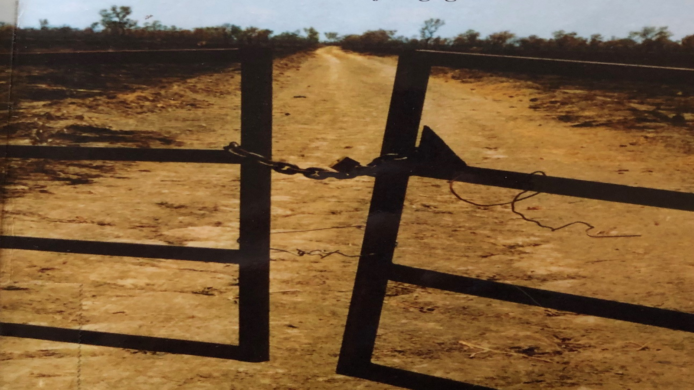
Thank you

